Slide 1
IT 705 PROJECT MANAGEMENT
Waterfall/Project Management!

Slide 2
What is a Project?
A unique process, consisting of a set of coordinated and controlled activities with start and finish dates, undertaken to achieve an objectives conforming to specific requirements, including constraints of time, cost and resources.¹
OR
A project is a temporary and unique work effort with a beginning date and an end date that creates a product, service, or result.²
1- Project Management, Planning and Control : Managing Engineering, Construction and Manufacturing Projects to PMI, APM and BSI Standards, Elsevier Science & Technology, 2013, pg. 1
2. The Project Management Answer Book, 2nd Edition by Jeff Ferman, Chap 1, Q1

Slide 3
What is a Program?
Program is the management of two or more inter-related projects
FOR EXAMPLE
PROJECTS |  | PROGRAMS
Building a canoe |  | Building a navy Projects Harbors Cruisers Submarines
Building a Mobile Pizza Ordering Site |  | Online Pizza Ordering Projects Mobile Web Customer Service Restaurant Site Management Reporting

Slide 4
What is a Project Manager?
Once a project is defined the Project Manger is the person responsible for the project’s:
Planning
Coordination
Communication
Tracking
Supervision
These activities collectively is referred to as Project Management

Slide 5
PMI 5 Project Phases
Initiating
Project charter
Stakeholder identification
Planning
Project scheduling
Quality Plan
Risk identification
Procurement Plan
Executing
Direct and manage project
Conduct procurement
Engage stakeholders
Monitoring and Control
Budget and Project Plan tracking
Manage and mitigate risk
Change Management
Status and communication
Closing
Deliverable Complete or Project Abandoned
Transition to closure and ongoing maintenance
Project Plan Updated
Budget/cost summary
Post project findings and feedback

Slide 6
What is a Project Charter?
Serves as an agreement and as a communication tool for all of the project stakeholders
SECTION | DESCRIPTION
Project Overview | Describe the product or service of the project, the reason the project was undertaken, and the purpose of the project.
Project Objectives | Describe the overall objectives of the project and what factors will determine the success of the project.
Business Objectives | State the reason this project is needed and what problem or issue the project will resolve. Describe the impacts to the organization if the project is not approved.
Resource Costs and Estimates | Provide cost estimates if known, including monies already expended such as a feasibility study or consulting time.
Roles and Responsibilities | List the project team members, stakeholders and their responsibilities.
Signatures | Include signature lines for the project sponsor, project manager, key stakeholders, key management (i.e., developers)customers, and vendors.
Attachments | Any key supportive documentation (vendor or product descriptions if purchase product is involved)
Source: Project Management Jumpstart by Kim Heldman p. 301

Slide 7
CLASS EXERCISE
CREATE A PROJECT CHARTER TO CREATE “Car Charge B&B”

Slide 8
Project Team
DIRECT | INDIRECT
Project Manager | Managers of direct team members
Project Sponsors | Staff of other applications what may have an interest
Business Analysts | Stakeholders beyond the direct project team
Developers (staff or consultants) | Portfolio/Program Managers
QA/Testing Staff
Architects
Database Administrators
User Interface Designers/Researchers
Business Subject Matter Experts/Acceptance Testing Team

Slide 9
Key Project Meetings
Charter Review and Signoff Meeting
Project Kickoff Meeting
Status Meeting
Weekly for core project team
Bi-Weekly/Monthly for Stakeholders
Verify project plan updates
Review and update risk
Review significant project dependencies
Update stakeholders
Review project budget and timeline
Change Management Meeting
Required when changes to the scope of the project is impacted
Project Close Out Meeting
Verifying Implementation
Review timeline & budget
Release staff from project
Transition to maintenance
Hold “Lessons learned” session

Slide 10
TRIPLE CONSTRAINT
Typically it is the project team members who will incur stress when Scope Expands
COST
SCOPE
SCOPE
COST
SCOPE
COST
TIME
TIME
TIME
PROJECT START
SCOPE & COST EXPANSION WITH SAME DELIVERY DATE
SCOPE EXPANSION WITH SAME COST & DELIVERY DATE

Slide 11
Project Scope
IN-SCOPE STATEMENT:
The scope boundary and scope statement provide a understanding of key features, capabilities, and expectations that are WITHIN the domain of the project
OUT OF SCOPE STATEMENT
Along with the In-Scope Statement, the Out of Scope Statement is important in allowing everyone to clearly understand those features, capabilities, and expectations that are BEYOND the domain of the project.
Taken together these statements helps to clarify, from the onset of the project anyone’s assumptions of the projects deliverables (features, capabilities, expectations, costs, and timeline.

Slide 12
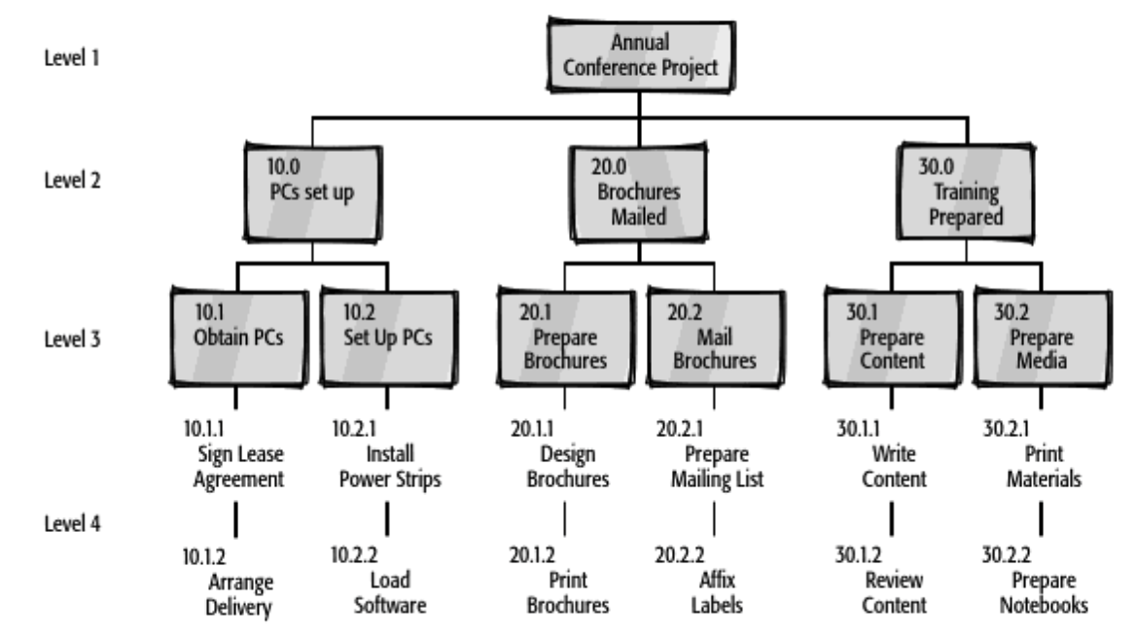
Work Breakdown Structure
A Work Breakdown Structure (WBS) is a tool used to graphically display the deliverables of the project in a hierarchical fashion.
Project Management JumpStart, Kim Heldman, pg 110-112

Slide 13
CLASS EXERCISE
CREATE A WORK BREAK DOWN STRUCTURE
For…
THANKSGIVINGS DAY
Include: Activities & Meals

Slide 14
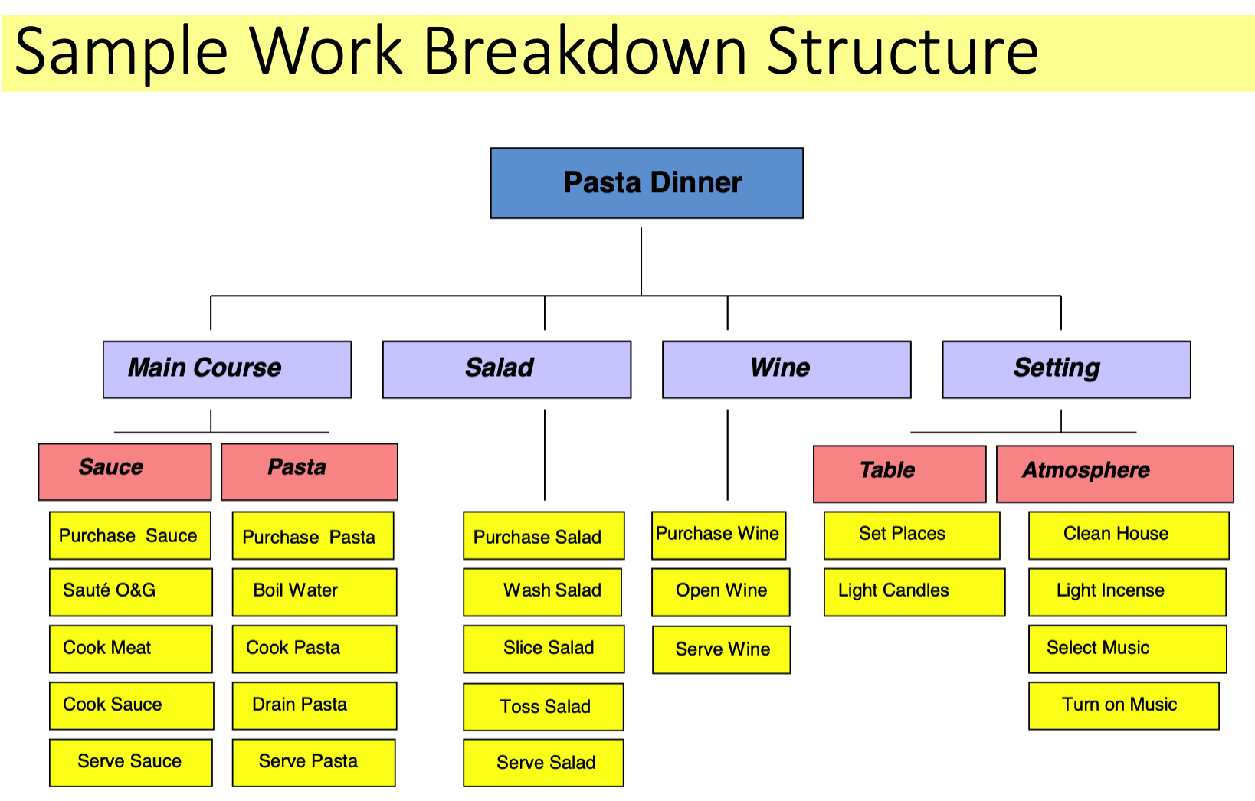

Slide 15
Estimation Techniques
Analogous | Estimates based on similar project tasks that were successfully completed in the past
Bottom-Up | Project Manager (PM) and Development Team estimate all of the lowest elements of the WBS related to the project that they are responsible to work on.
Top-Down | Using an Analogous approach only the higher levels of the WBS are estimated with the assumption that the lower level nodes of the WBS would generally sum up to that estimate
Delphi Technique | The Development Team Members meet and submit their estimates without the PM or management present. Difficult to follow up on the estimates, and illustrates an possible issue with organizational culture
Expert Opinion | Someone other than the Development Team who is doing the development will provide the estimate. This is typically done to save time and is more simple.
* Additional estimation techniques are described in Project Management Answer Book by Jeff Furman, Chapter 5

Slide 16
Project Planning
Network Node Diagram
- A flow diagram that illustrates the sequence of activities (predecessors, successors, and dependencies) required for various portions of the proeject
CRITICAL PATH
- A chain of activities that represent the longest path/duration of activities for the project

Slide 17
Project Planning Activity Constraints
Buy Land
Clear Land
FINISH - START
Dig Trench
Remove Excess Dirt
START - START
Cut Onions
Cut Carrots
FINISH - FINISH
START - FINISH
Empty House
Sign Purchase Contract

Slide 18
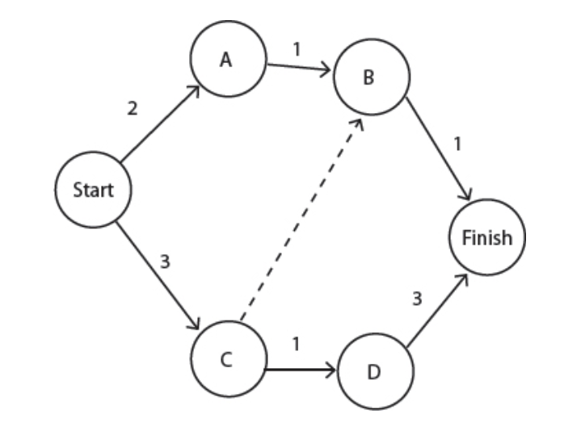
Project Planning – Arrow Diagram Method
Paths: Duration
Start-A-B-Finish 4
Start-C-D-Finish 7 CRITICAL PATH
Start-C-B-Finish 4

Slide 19
CLASS EXERCISE
CREATE A NETWORK DIAGRAM BASED ON YOUR ONE OF YOUR FIRST LEVELS OF YOUR THANKSGIVING DAY WBS

Slide 20
Key Terms Associated with Critical Path
Term | Definition | Comments
Float | The amount of extra time an activity can take to complete without making the entire project late | Float of a Critical Path = 0
Free Float | The float between two consecutive activities. It indicates how late a predecessor activity can be without delaying its successor activity. | Free Float is not dependent on the critical path and only focuses on 2 consecutive tasks
Early Start | The earliest date an activity can begin
Early Finish | The earliest date an activity can finish
Late Start | The latest date an activity can begin
Late Finish | The latest date an activity can finish based upon a late start date
Lag | A delay built into the schedule on purpose
Lead | Starting an activity at it’s earliest possible date | The task may finish well before it’s successor activity, but doing so, reduces the risk if that task runs into unexpected delays

Slide 21
Project Planning – GANTT CHART
GANTT CHART
Is a linked bar chart that illustrates activities’ durations, dependencies, start and finish dates, and resources Most common tool is MICROSOFT PROJECT

Slide 22
CLASS EXERCISE
Create a Gantt Chart based on hours for your Thanksgivings Day Meal

Slide 23

Next Class AGILE ORIGINS, VALUES, PRINCIPLES

